Slide 1
KONY PRODUCT Agile Transformation Plan
Uttam
https://konyone.sharepoint.com/sites/PMO

Slide 2
“Agile is a growth mindset. It’s
a way of working grounded
in a culture of learning.”
Ahmed Sidky (Aka Dr. Agile)
Agile Transformation
Implementation Plan
Call to Action & Project Mgmt
The Tipping Point
Build the Coalition
Define the Guiding Vision
- Agile Framework
Communicate and Begin Training
- Agile Training
Empower Teams
- Agile Tooling
- NFR Catalog & Quality Gates
Launch Agile Release Train
John Blanco — Enterprise Agile Transformation Leader
Extend to Portfolio
- Agile Product Management
Sustain and Improve
- DevOps & Continuous Delivery
- Metrics & Maturity Models

Slide 3
About this document:
Agile Transformation is hugely complicated effort and requires a similarly complex implementation plan with lots of moving parts. The details matter. As such, there is a significant amount of detailed information included here and even more in accompanying documentation on our internal Agile Transformation Portal. As such,
“This document is intended to be read as an introduction and referenced as a plan of record throughout this transformation.”
Continuous review and iterative refinement of our Agile Transformation plans and engineering process definitions will be captured and managed in this document which is maintained on the PMO SharePoint site: https://konyone.sharepoint.com/sites/PMO
As specific engineering processes are reach “design complete,” formal processes definition and execution guidance will be more memorialized and documented in the Product Engineering System documentation in Confluence: to be defined during planning
Contacts: PMO PMO@Kony.com / Uttam Bhatta uttam.Bhatta@kony.com / Alex Cobb alex.cobb@kony.com

Slide 4
Agile Transformation Journey
Successful implementation of Agile in a large, complex, enterprise organization is never a one-size-fits-all solution. Every company is different, with uniquely challenging team dynamics, cultural factors, values, and legacy processes. Many of the problems that companies face seem similar on the surface, but assessment of Agile maturity and capabilities often reveals unique challenges and opportunities. Implementing a methodology, which touches people and technology, requires finesse, careful preparation and patience.
This plan will reveal that after researching Agile framework, best practices and case studies, we selected
“Scaled Agile Framework for Lean Enterprises (SAFe)”
as the foundational framework for our Scaled Agile practices and implementation plan. SAFe is not a silver bullet solution. But it does provide industry tested best practices and guidance for Agile Transformation at Scale.
We investigated new Agile frameworks because vanilla Agile and Scrum fails under the weight of enterprise-sized teams and complexity of product portfolios.
SAFe is well recognized as an leading Agile framework, but the decision was made after review of implementation case studies from comparable organizations (Bloomberg, ANZ Bank) and our affinity toward the SAFe Core Values:
Alignment: Engineering investment and execution informed by and in sync with portfolio strategy
Built-in quality: Incremental delivery validates quality early and often, while capacity planning maintains technical debt and enables predictable delivery
Transparency: Visualize all relevant work. Inspect and adjust plans, proactively mitigate risk and measure feasibility, capacity, and capabilities of the organization
Program execution: Focus on working systems and business outcomes. Leaders participate in planning, execution and reflection, adjust scope to assure demand matches capacity and aggressively remove impediments.
The plan itself is a “Fast Track” customization of the standard SAFe Implementation framework, which is often executed over many months, even years. We focused on our most urgent pain points and tailored to enable us to quickly and safely realize and validate results and establish a foundation for continuous improvement of our Engineering practices.

Slide 5
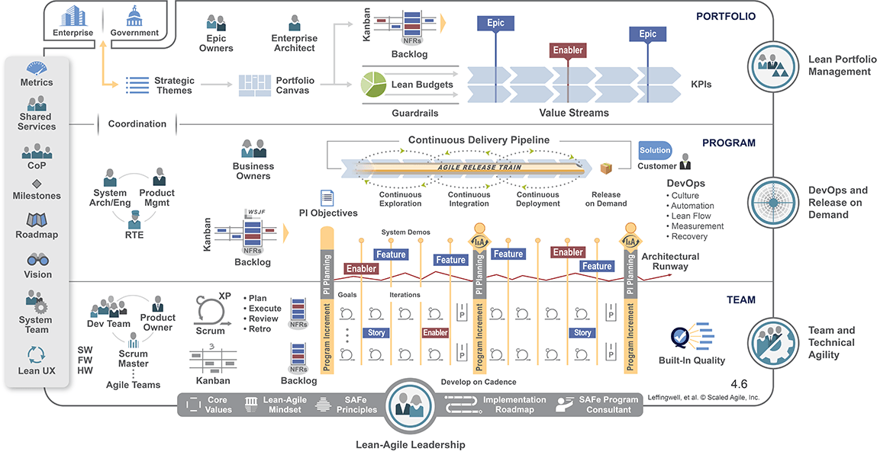
Scaled Agile Framework for Lean Enterprise (SAFe)
Plans informed by SAFe process definition, implementation guidance and training materials

Slide 6

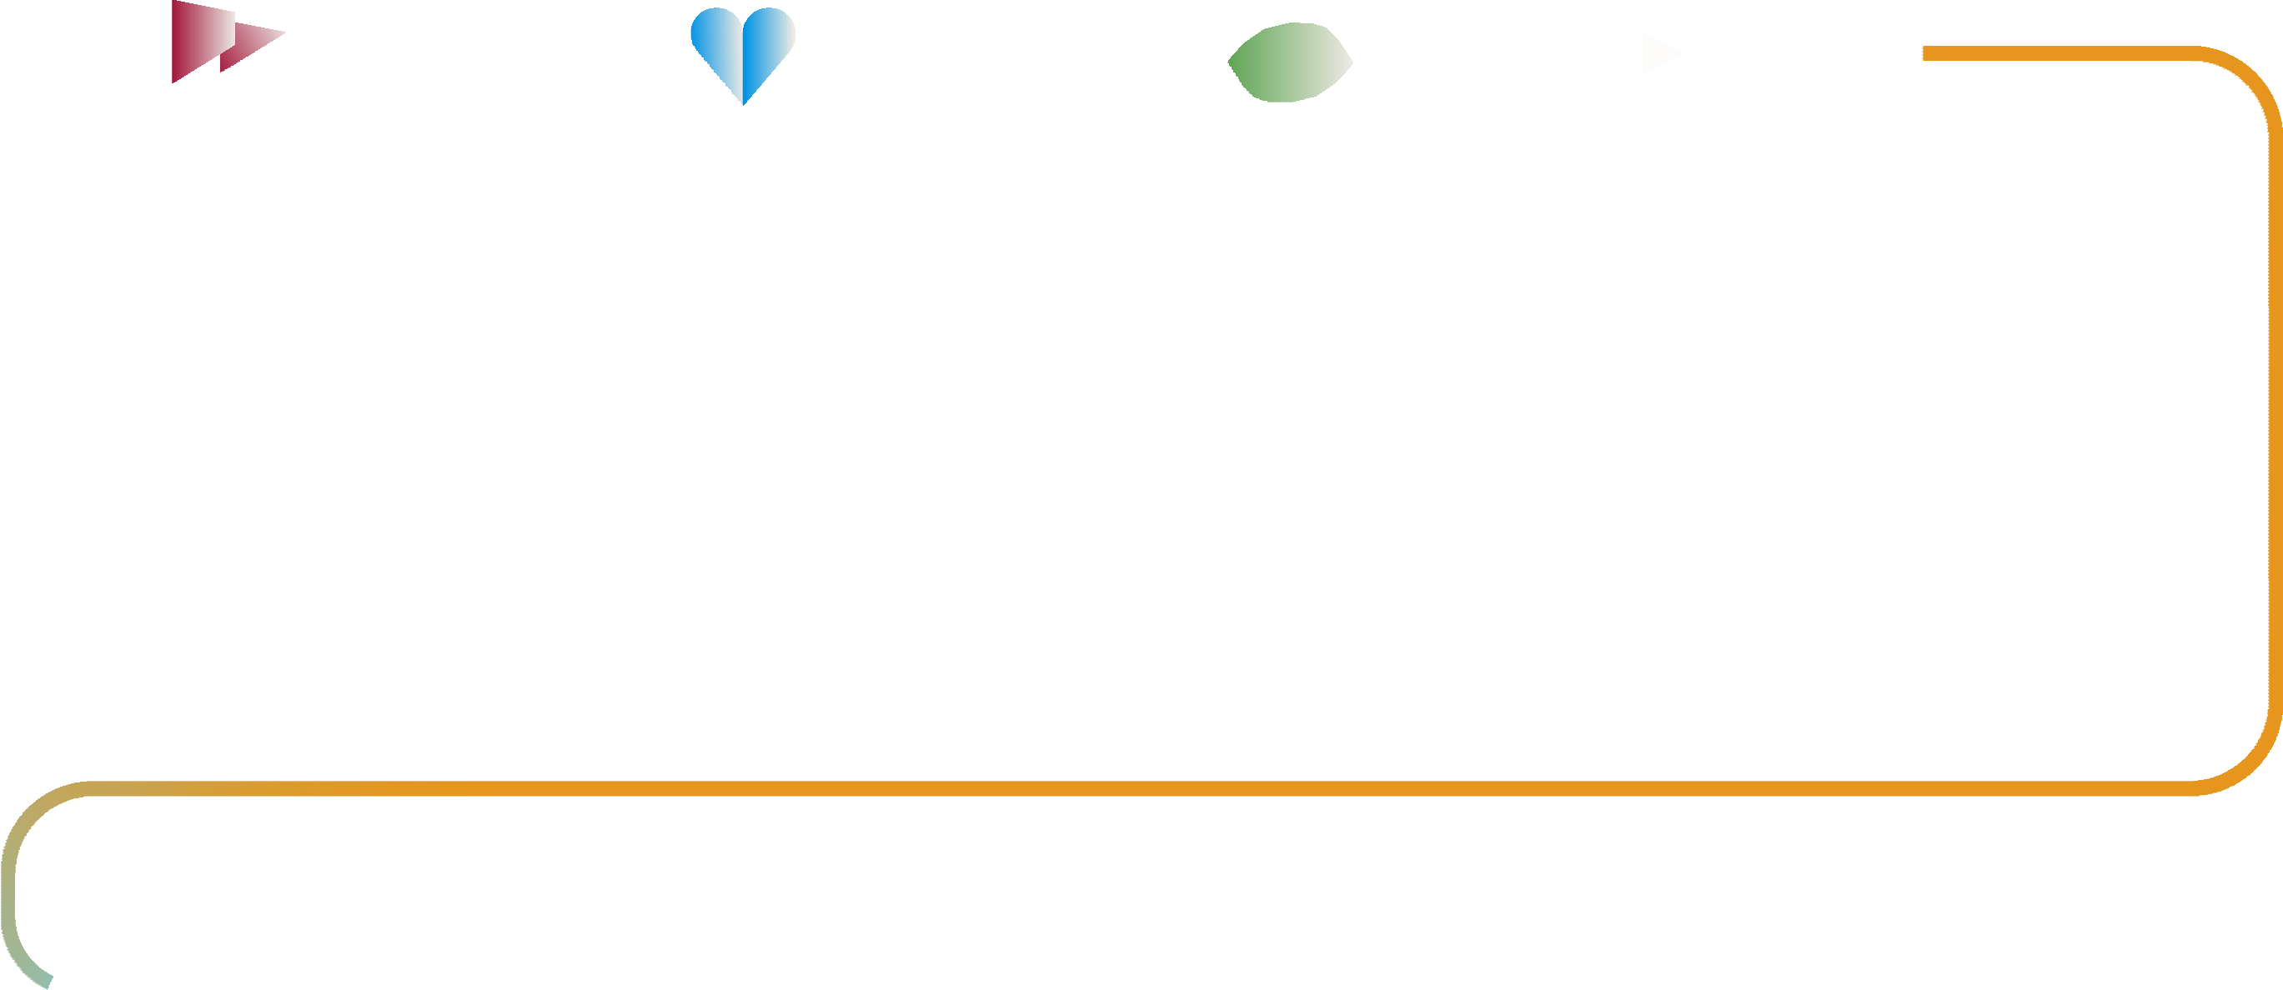











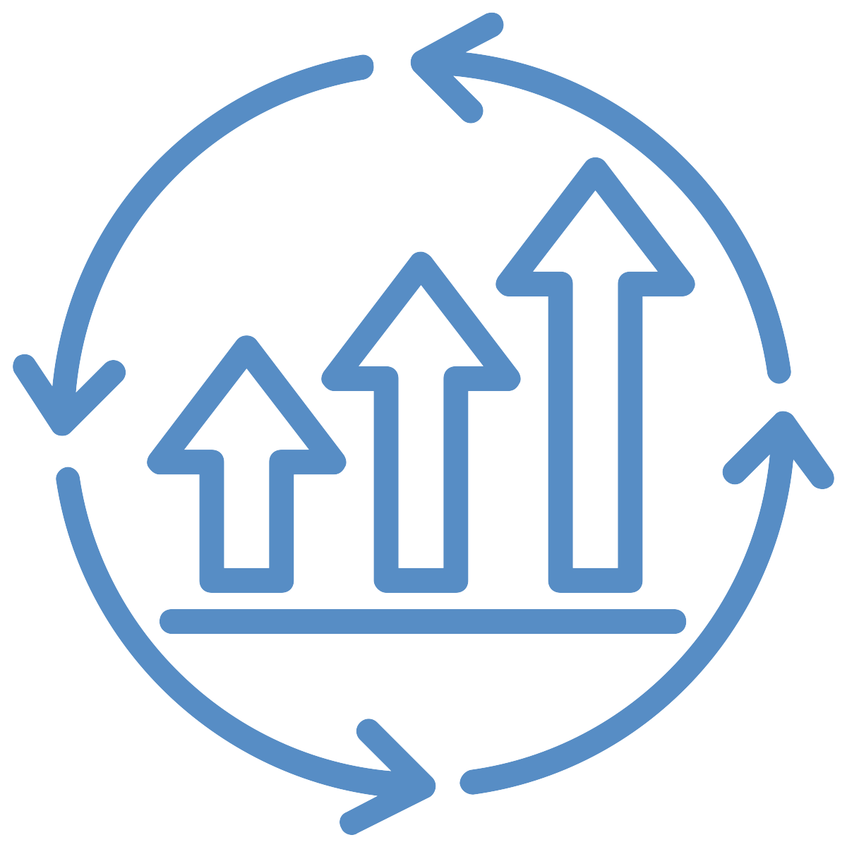
“Fast Track” Agile Implementation Roadmap
Tailored and accelerated for Kony Product Engineering
The Tipping Point
ESTABLISH A SENSE OF URGENCY
Assess organization capabilities
Identify needs, risks and urgency
Build the Coalition
CHANGE AGENTS TO MAKE IT HAPPEN
Assemble working group
Establish PMO as Lean-Agile Center of Excellence (LACE)
Define the Guiding Vision
DESTINATION AND PATH TO GET THERE
Select, customize Agile framework
Define implementation plan and success metrics
Communicate and Begin Training
START BY ENABLING LEADERSHIP
Communicate vision and plan
Begin training:
- Implementing SAFe
- Leading SAFe
Empower Teams
ORGANIZE AND ENABLE TEAMS
Defined Processes & Configure Tools
Continue training
- SAFe for Product Owners
- SAFe for Scrum Masters
- SAFe for Teams
Launch
COACH, INSPECT & ADAPT
Facilitate and coach teams
on org-wide rollout
Inspect and Adapt each sprint and release
Manage as Portfolio
ALIGN BUSINESS AND ENGINEERING
Adopt Portfolio Management tools and processes
Align engineering investments and business portfolio objectives
Sustain and Improve
CONTINUOUS IMPROVEMENT
Invest in DevOps and
Continuous Delivery
Refine processes using
empirical data and learning

Slide 7
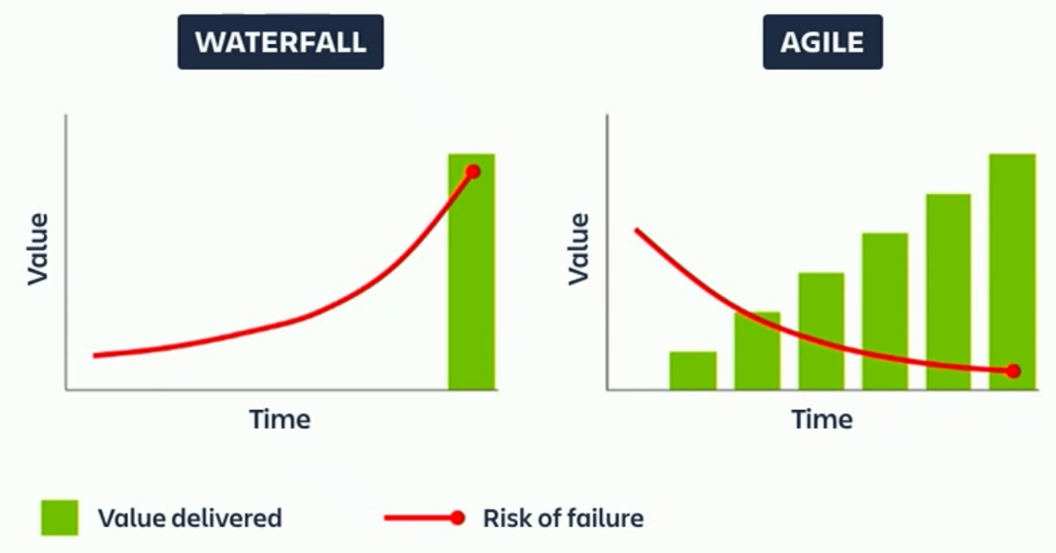
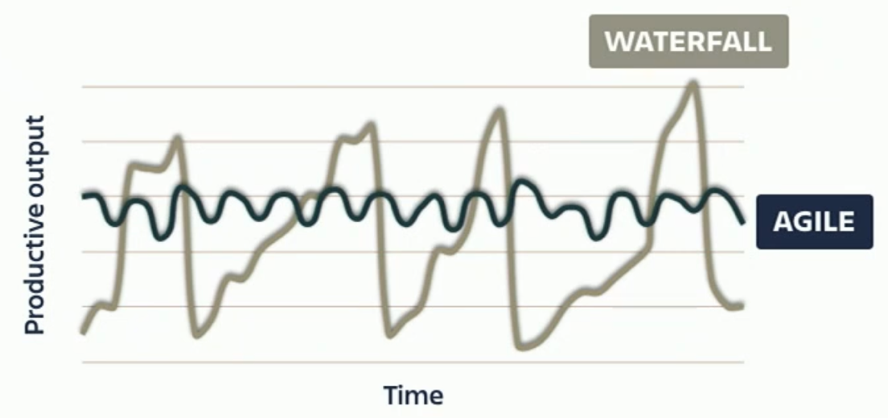
The Tipping Point
Sea change transformation to Agile needed
ad hoc Agile insufficient for critical capabilities
At some point, every organization reaches a
Tipping Point — an event, or series of events,
that require rethinking of business operations.
The business impact of poor Product Quality
was the Tipping Point for Kony Engineering
Once identified, it was critical to establish the importance and urgency to take action including defining business goals and justification to invest in this transformation.
Product Quality is now clearly identified as an company wide imperative with support from the CEO down.
Collective wisdom across business and engineering teams, supported by 3rd party engineering capability assessment from Crosslake identify urgency and dependency on Agile Transformation to resolve Product Quality crisis and achieve business goals.
Incremental execution and delivery reduces risk and improves predictability
Consistent flow increases efficiency
Capacity Planning
Dependency Management
Transparency and Data-Driven Decision Making
DevOps and Continuous Delivery

Slide 8
Build the Coalition
This group’s success requires:
Transformation Vision. Passionate people, unafraid of adversity, who are accomplished and experienced at removing impediments.
Change Agents. Knowing what to do is one thing. Making things happen is what it’s all about.
Leadership Support. Leaders must lean-in, be proactive and consistently enthusiastic in re-enforcing the importance and value of transformation. And back that up with funding.
Organizational Credibility. We need people who influence others. They must be visible, available and hands-on to lead by example.
Actions:
Kick-off Transformation. Present findings and establish consensus on problems to gain buy-in for Agile Transformation. The Quality presentation to the ELT was arguably a kickoff of Agile Transformation.
Hire/Identify and train SAFe Program Consultants (SPCs), and position them as change agents/coaches. Harsha Chetwani, already a SAFe Coach, Agilist and Practitioner, recently joined the PMO to drive this effort. Additionally, we’re currently sourcing a SAFe certified training vendor to facilitate the leadership and engineering-wide Agile Training Plan.
Establish PMO as Lean-Agile Center of Excellence to drive consistent changes across the organization. This group will also govern and sustain the principles of the transformation on an ongoing basis. But, first they need to invest in further developing their own Agile skills and capabilities.
SAFe directs that although management may recognize existing problems, or have a healthy sense of danger, they rarely can focus on driving the solutions, or making “in-the-trenches” decisions. Therefore, it’s important to form a team that can think and do.

Slide 9
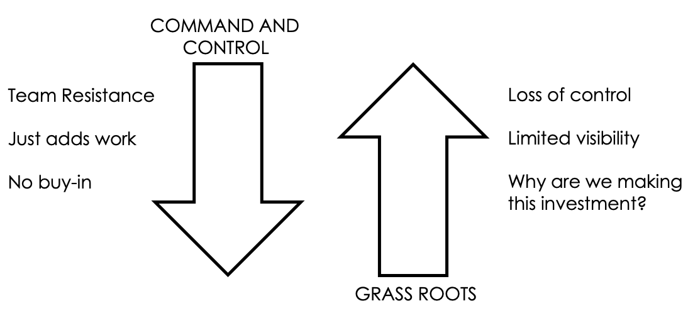
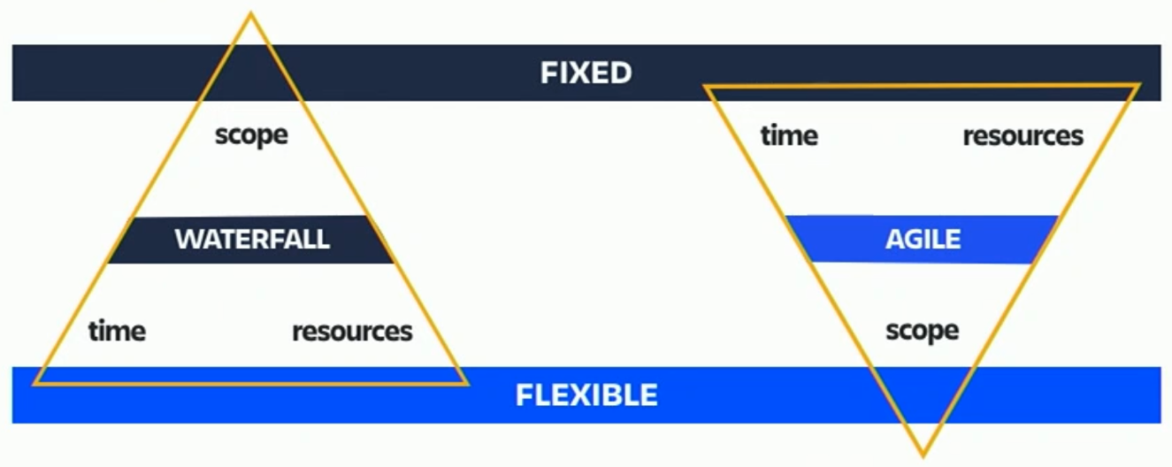
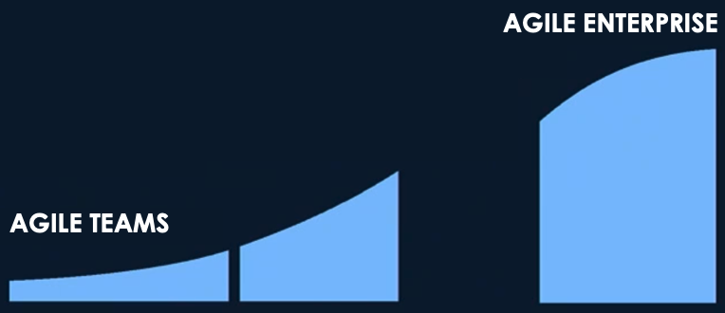
Shared Vision needed to guide teams thru Transformation
2. Top-down transformation will fail…
…so will bottoms-up
The Guiding Vision is not a list of requirements or a specific solution, but rather a shared North Star objective and guidance to help teams make the profound mind shift required. The first step on that path is to acknowledge and embrace the epic challenges and changes needed to move from Waterfall to Agile.
1. Agile Turns Development Constraints Upside Down
Numerous teams operating together to deliver a product portfolio adds complexity resulting in the breakdown or failure of many basic Agile practices.
Organizations cannot cross this chasm without aligning on a common held vision
3. Agile Teams is hard, Agile Enterprise is harder
Top-down command and controls doesn’t work as teams resist change without shared values and vision.
Bottoms-up also doesn’t work as teams don’t self-align or enforce consistency without shared directive.

Slide 10
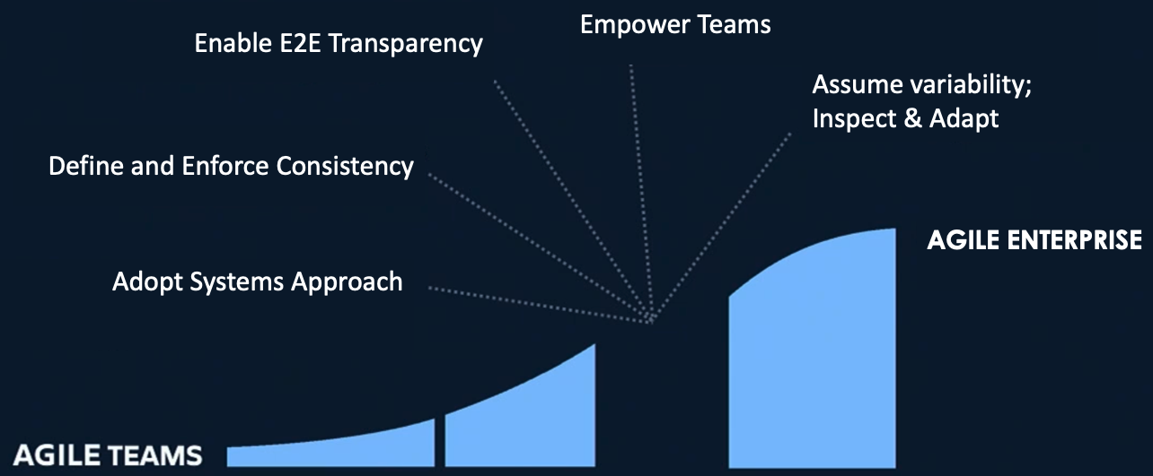
Define the Guiding Vision
based on Principles of Scaled Agile Framework for Lean Enterprise (SAFe)

Slide 11

Essential SAFe is our first step…

Slide 12
Communicate and Begin Training
We must ensure that committed transformation Leaders and Change Agents have the necessary knowledge, skills and traction for the long haul.
Many of our scaling techniques are not normally found in standard Agile or Scrum. We must collectively adopt new Scaled Agile practices. This is often best achieved by hosting training as a big room event to accomplish the following:
Allow the teams to fully form
Enable teams to collectively engage in the learning experience
Share knowledge around concepts like Epics, Capabilities, Features, User Stories, etc.
Give teams time to begin forming unique identities
Actions:
Communicate Agile Transformation Plan including goals, participants, roadmap, tools and process documentation, support channels and available resources.
Publish Agile Transformation Portal as singular point of discovery for all Agile Transformation guidance, resources, tools, training schedule, roadmap and imitative communiques.
Training:
Schedule SAFe Agile Transformation training for Leadership and Change Agents. This course forms a shared understanding of the SAFe methodology:
Leading SAFe
Schedule SAFe Implementation training for Change Agents. This course forms a shared understanding of the SAFe Implementation framework:
Implementing SAFe
Provide individual self-serve, Agile practices training to All Engineers and track completion results.
Agile Practices (Scrum, Kanban)
Agile Tools (Jira, Confluence)

Slide 13
Empower Teams
It’s now time to create teams and empower the people who will do the tactical work to deliver results.
Adopting new practices may require unlearning old practices and habits. The most critical new practice ceremonies in the evolution of an ART — or possibly a business’ entire transformation — bookends the start and end of every Program Increment (PI). Thoughtfully prepare for and facilitate the PI Planning event to ensure proper execution.
Actions:
1. Create Feature Teams
As with smaller Agile implementations, teams consist of product owners, scrum masters and development team members. With SAFe, it can also be necessary to include a Product Manager (PM) and a Release Train Engineer (RTE).
2. Define the Kony Agile Process
Stay true to the Agile spirit and give teams the flexibility to choose and blend Agile practices. But, continue to enforce end-to-end transparency and consistency at integration points.
Scrum, Kanban, etc.
2. Update Agile Tools to reflect Kony Agile Processes
Jira, Confluence
Training:
Schedule role-specific training for key Agile roles, Product Owners and Scrum Masters:
SAFe Scrum Master
SAFe Product Owner
Train the Teams as a Team. Remember, people are not Agile, Teams are Agile.
SAFe for Teams

Slide 14

Launch
Leading change within an organization’s culture is not a trivial task. We must change people’s behaviors, roles and expectations.
“In SAFe, Agile Teams power the Agile Release Train (ART) and are responsible for delivering large, complex solutions. No train can exist without its teams. And all teams are on a train, contributing to its Vision and Roadmap, collaborating with other teams, and participating in ART events. The teams and the train are inseparable; the whole is greater than the sum of its parts.”
Don’t be afraid of imperfection. We learn by doing.
Actions:
Announce org-wide launch and set expectations:
Announce launch to declare readiness, define expectations and inform teams of available resources and support channels.
Coach teams and facilitate Agile ceremonies
Schedule coaches to facilitate Scrum ceremonies and establish Coach office hours. Invite team members to cross-team collaboration channels for questions and sharing learnings.
Initiate status/progress reviews and reporting
Publish reporting dashboards, initiate status communications and establish rhythm of Inspect and Adapt ceremonies. Overcommunication at launch is intention and well be reduced to sustainable levels as team maturity increases and exaction results evolve to be consistent.
Inventory of enablement resources :
Agile Transformation Learning portal (LMS)
Director of teams and roles
Agile process documentation (confluence)
E2E Agile practices & process posters
Quality gates
Jira project and Confluence doc space configuration
Support and social collaboration channels (Slack)
Transformation progress reporting dashboard

Slide 15


Release Cadence (DBX)
Prioritized Backlog / Estimation (story points) / Capacity based on Velocity / “Bug Jail” gates
quarterly
monthly
2 weeks
Hardening
Hardening & Planning
Hardening & Planning
4.3 Release
4.4 Release
4.2.3 Fix Pack
4.2.4 Fix Pack
4.3.1 Fix Pack
4.3.2. Fix Pack
Internal Engineering
Schedule
Sprint 1 Sprint 2 Sprint 3 Sprint 4 Sprint 5 Sprint 6
Sprint 1 Sprint 2 Sprint 3 Sprint 4 Sprint 5 Sprint 6
(June 3 – 14) (June 17- 28) (July 1 - 12) (July 15 – 26) (July 29 - Aug 9) (Aug 12 - 23)
Functional, tested sprints / Quality released often / Features released when ready

Slide 16
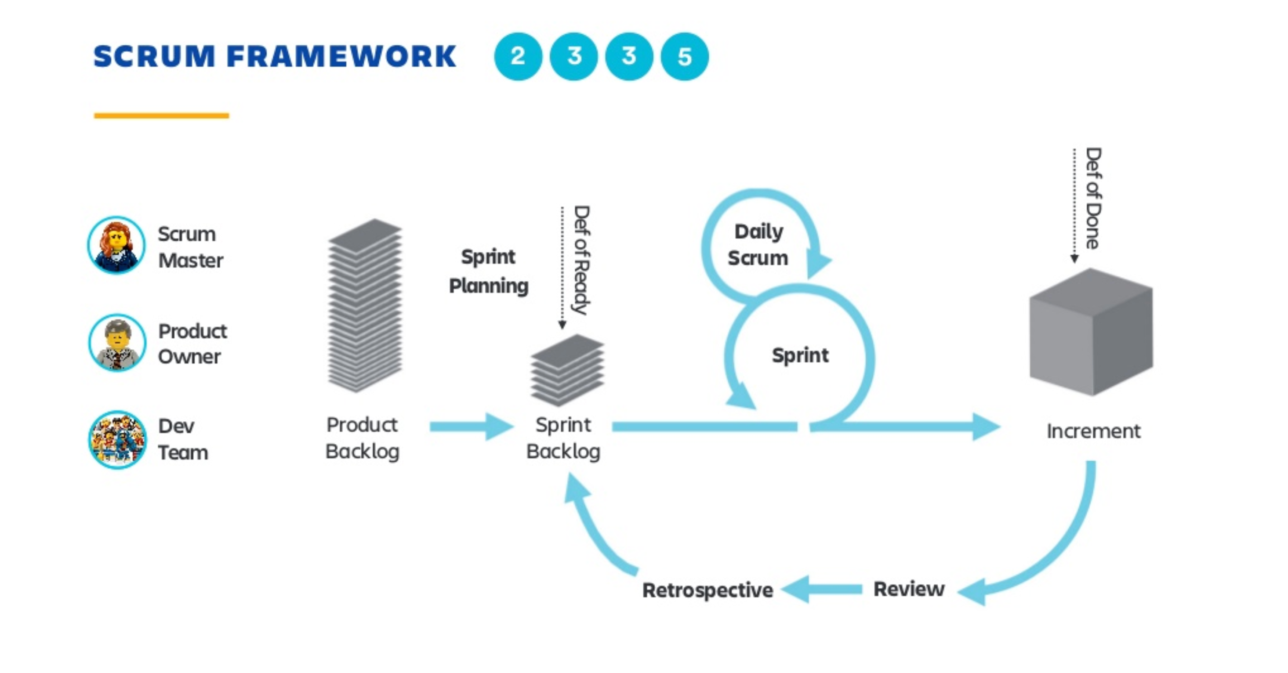

Slide 17
Manage as Portfolio (updates needed)
As the SAFe practices become natural, the transformation continues. The next step is to…
“Bring SAFe Portfolio level into the picture”
This depends on building up a strong Lean-Agile Program Management Office (PMO) to take charge and ensure that our transformation continues to take root, grow and mature.
The PMO will need to evolve to:
Lead overall improvements
Continuously align our Value Streams and new Value Streams
Maintain enterprise value flow
Implement Lean financial management and budgeting techniques
Align demand to capacity
Provide reliable Agile forecasting
All for the purpose of evolving the organization to leaner governance practices.
This may look like the end of the journey, but it’s actually the beginning of a new journey toward Agile Portfolio Management. Here, we reap the benefits of what we’ve started and employ them to make changes throughout the organization.
Other teams within the organization may not understand what we’ve accomplished. Expanding into associated areas like HR, Operations, Legal, Finance, Accounting, Sales, Marketing and more will benefit the entire business.
We are introducing a new way of doing things. A new way for teams to visualize work and measure their flow. We have brought other areas of the organization into play. This now creates momentum that impacts the Portfolio level, where ideas first arise, are judged and
ultimately funded.
We must be sure that we can adequately manage capacity, have better ways to cost account, apply value add Agile techniques, improve our ROI projection methods, strengthen our vendor management and mitigate our risks.

Slide 18
Sustain and Improve
In the real world, many companies see Agile Transformations as a way to tighten the delivery pipeline and ship products faster. Some believe that Agile has little impact on the company’s objectives, priorities, or direction. Unfortunately, this is short-sighted, for Agile has benefits across all areas of a company.
Sustaining Actions:
1. Maintain Agile process tools and docs:
Value our tools and documentation like we value our source code. No broken windows in our house.
2. Extend Agile to Entire Company:
Bring Agile methodologies and the necessary training to other departments like Marketing, HR and Finance.
3. Nurture Agile Leadership culture:
Evangelize and apply Agile methodologies to Leadership forums/activites across the company supported by continuing education on Agile leadership.
4. Nurture Engineering culture:
Build and facilitate internal Agile community including crowd-sourced curation of Agile news and industry trends, learnings materials, cases studies, videos and in-person social meet-ups.
Improvement Actions:
1. Engineering Rhythm of Business:
If you’ve introduced new metrics, hold sessions to help managers size initiatives’ progress in an Agile way, mitigate risks and create KPIs to measure scope fluctuation and value (i.e., Agile feature schedule health, acceptance value rating, scope fluctuation monitoring, etc.).
2. DevOps:
Planning in progress, ETA = ASAP
3. Continuous Delivery:
Planning in progress, ETA = ASAP

Slide 19
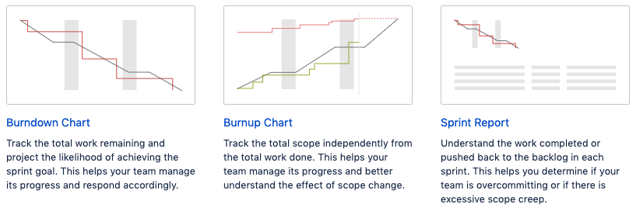
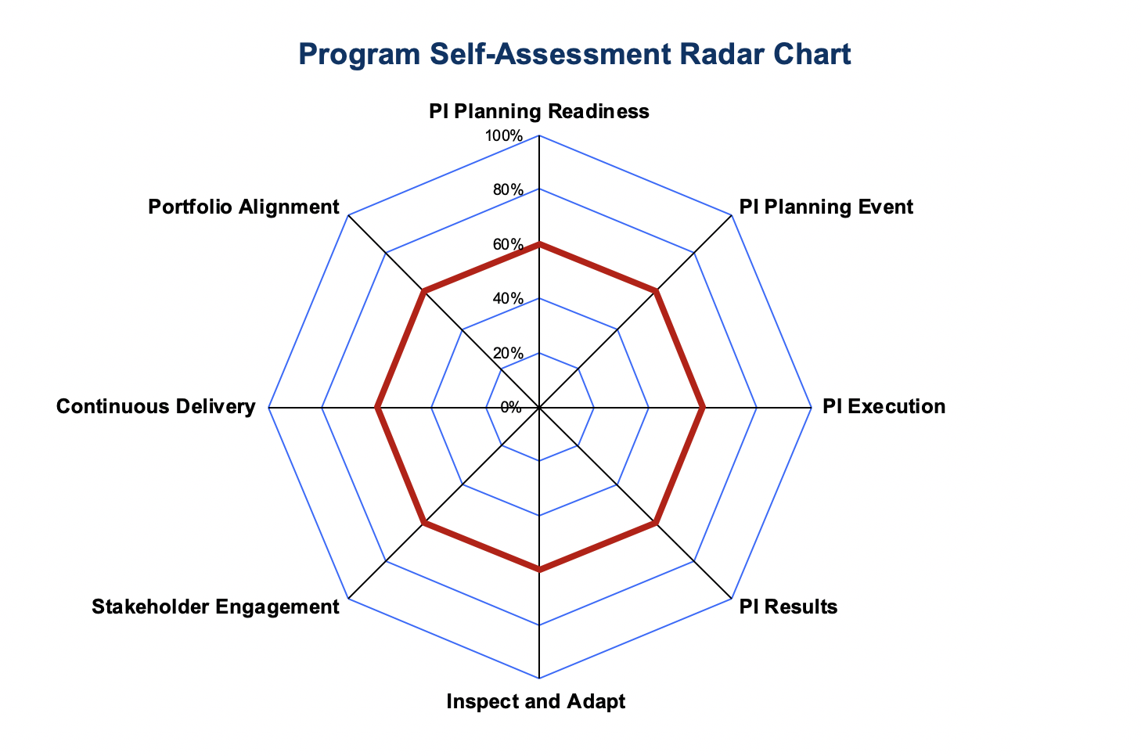
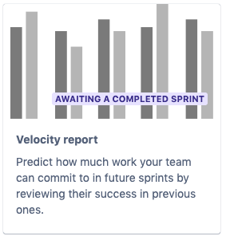
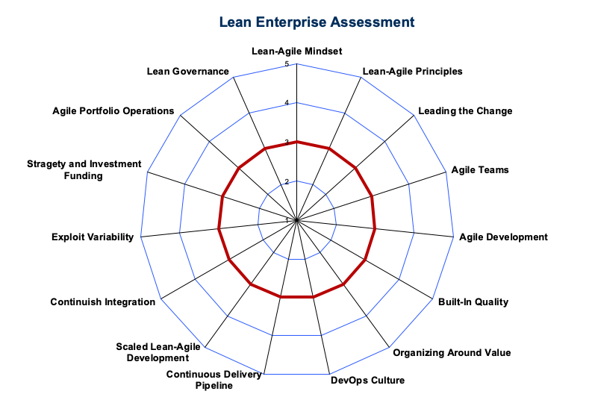
Metrics, Maturity Models & Review Cadence
Agile Transformation: Achievements
SAFe Essentials practices (Q1)
Test framework based on Quantum tools (Q1)
SAFe Full practices(H1)
Rhythm of Business – review cadence
Sprint and Release retrospectives
Product QBR
Crosslake Checkpoint (review on progress and plans)
Execution: Sprint/Release Metrics
Sprint and release burndown
Sprint velocity
Scope change
Team capacity
Capability: Maturity Model
Team Maturity
Product Group Maturity
Business: Product Scorecard
Escaped Defects ≤5
Meet/exceed Engineering productivity
Meet/exceed Opex AOP targets
20/20 Time-to-Value > 75%
NPS score (@ 6-9 months)
Free trial funnel –live apps > xx%
CSAT Score >=80%

Slide 20
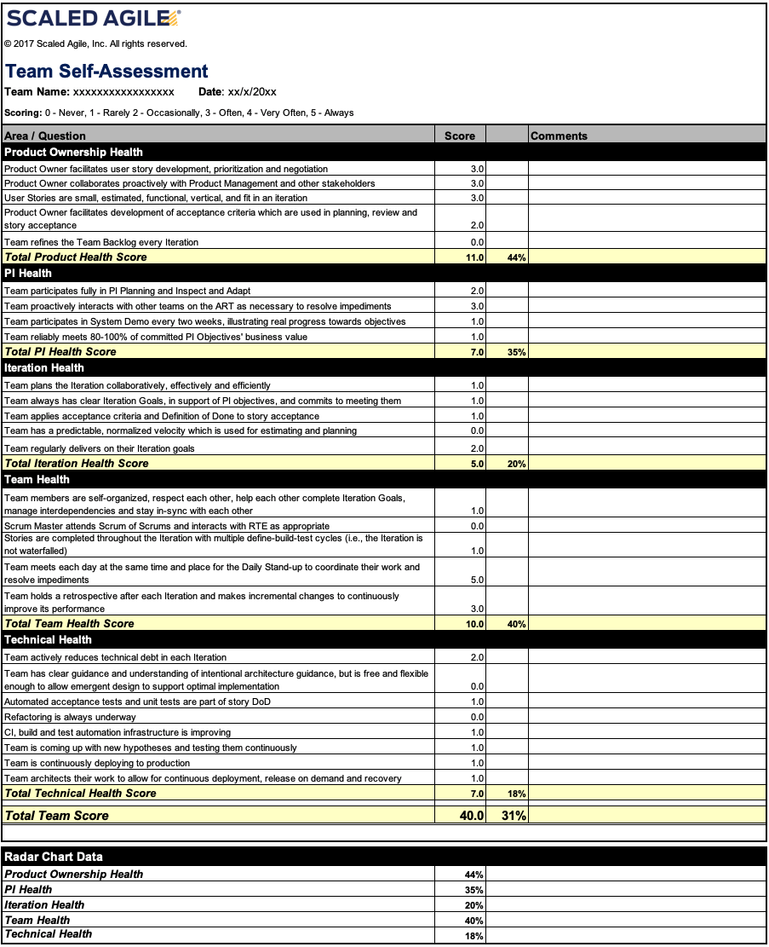
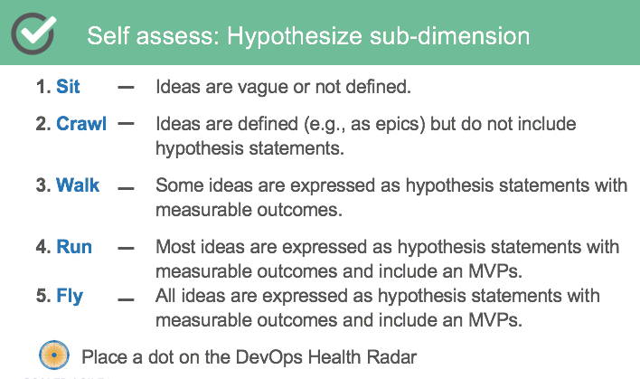
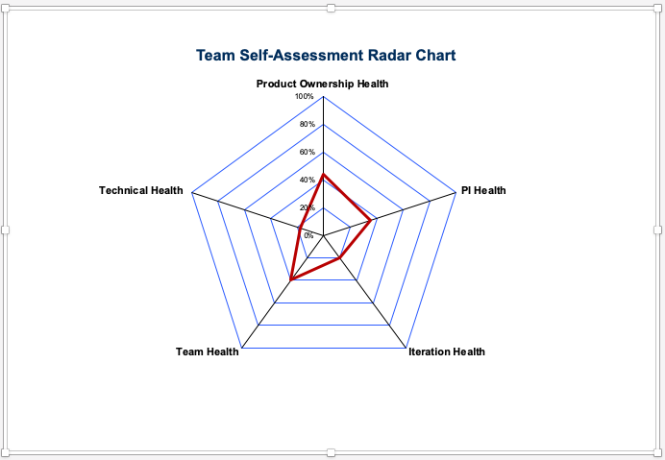
Maturity Model details
The Agile Team Maturity Model is used by teams to baseline relative Agile maturity and then self-assess quarterly and/or after product releases to measure progress.
Maturity Assessment: Templates
Team Self-Assessment
Program Self-Assessment
Lean Enterprise Assessment
DevOps Health Radar

Slide 21
Call to Action & Project Mgmt (to be updated with pointer to content on Agile Portal)
To be updated

Slide 22
APPENDIX

Slide 23
Quality

Slide 24


Pyramid of Testing - Kony
Non-functional Requirements
(driven by business and design)
Performance and capacity
Security
Reliability
Operability
Compatibility
Installation
Availability
Cognitive Walkthroughs
Usability
UI / UX - Indexing
Visual QA
Business Facing
User Acceptance
Testing
Customer/User Journeys
Contract Acceptance Testing
Operational Acceptance Testing
Security and Performance
Integration Testing
[ Z %]
Coding standards/Checklists
Code Reviews
Code coverage
Dynamic and Static analysis
Stubs and Mocks
API Specifications/Contracts
API Testing
[ Y %]
Technology Facing
Unit Testing
[ X %]
Internal – 'Escape Defects' Trend

Slide 25
User Experience
NFR Catalog & Quality Gates
Information Architecture
Wireframes
UI/UX Design
Interaction Design
UI Development
Application testing
Visual Design
QA (User Testing)
SketchFlow
QA
Mind maps
Visual QA
Product Backlog
Initiatives, Themes
Epics, Stories
Non-Functional
Requirements
output
Q Gate
Q Gate
Q Gate
Q Gate
Enterprise Architecture
Strategy
Solution Design
Implementation
Platform development
Application testing
Design standards and QA
Unit Testing
API/Integration
Static Code
CI/CD enabled
Structure
Purpose
Practice
Standards and QA
Engineering Excellence

Slide 26
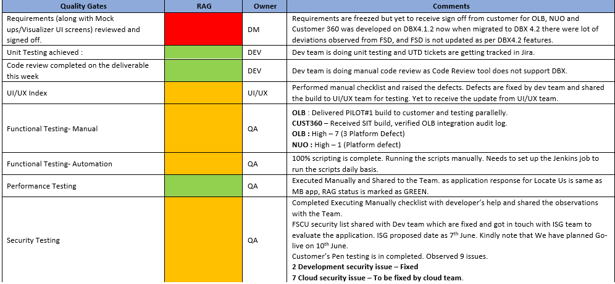
Quality Reports

Slide 27

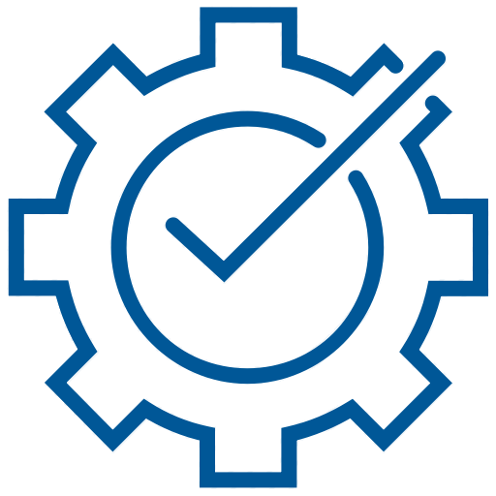
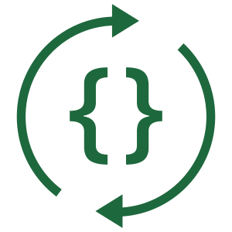


Quality Pillars
Escape Defects
Common testing
Performance
Tooling and
Security
Enhance controls
CI/CD
Always shippable
>5x faster web
Engineering;
main, automation
at every step
tools/frameworks;
Investments in
Quantum v9
& processes; new
web obfuscation
& guards
Customer blocking
defects discovered
post GA
Test Automation

Slide 28
Agile Capability Assessment (Crosslake March ‘19)

Slide 29
Capability Assessment (Crosslake March ‘19)
Inflection point on urgency to invest in Agile & Quality engineering excellence
ROLES & RESPONSIBILITIES
Quality accountability
Architecture accountability
Onboarding & Training
STRATEGY ALIGNMENT
Roadmap aligned w/ business objectives
Roadmap aligned w/ engineering capacity
Limited investment in Architecture & Quality
INFRASTRUCTURE
WiFi/Internet connectivity
Laptop & Monitor refresh
SOFTWARE DEVELOPMENT LIFECYCLE
Hybrid waterfall/agile model
Portfolio Management
Requirements & design documentation
Config & Adoption of Agile tooling
Estimation and Capacity planning
Burndown and Velocity tracking
Dependency tracking
Continuous Integration/Deployment (CI/CD)
Structured QA methodology & tooling
Schedule & Status transparency
Metrics & Dashboard driven development

Slide 30
SAFe

Slide 31
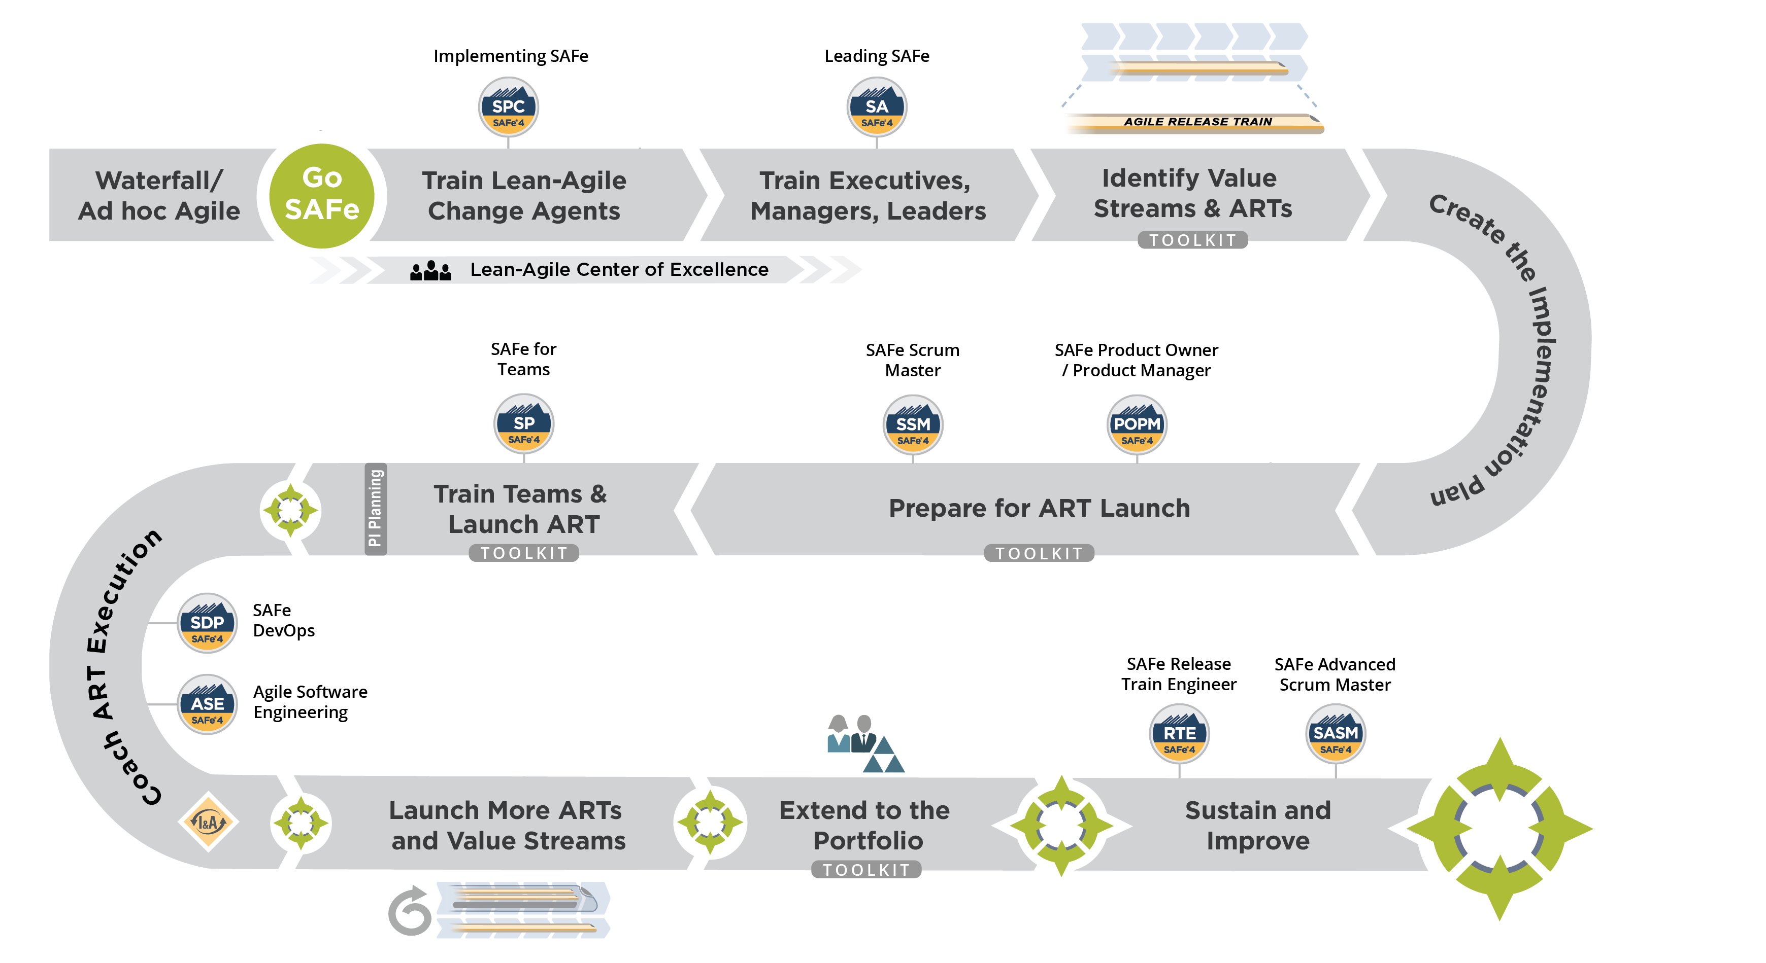
Scaled Agile Framework for Lean Enterprise (SAFe)
Plans informed by SAFe process definition, implementation guidance and training materials

Slide 32
Boneyard
(draft slides and content)

Slide 33











Agile Release Train (ART)
Fast Track Roadmap / Launch and Execute the ART
ART Sync
Scrum of Scrums
PO sync
Release Management Meeting
System demo
PROGRAM EVENTS
Daily Stand-up
TEAM EVENTS
PI Planning
Inspect & Adapt
Prepare for PI Planning

Slide 34
Agile @ Scale is hard, quality suffers
“Our Agile teams are not predictable, and we have technical debt”
“We need DevOps and continuous delivery to keep up with competition!”
“We build really big systems, subject to rigorous compliance, it takes hundreds of people, and we can’t integrate continuously.”
“We want to be Agile, but customers demand features faster than we can deliver them.”

Slide 35
Organized for Quality
Engineering Lead
Head of Quality
Quality CoE
GS VPs of Delivery
DBX CoE
EM1
EM2
EM3
Quality Architect(s)
UX QA Director
Product Mgmt
PMO
Scrum teams responsible for quality and test automation
Scrum teams include embedded Product Owner & UI Devs
Senior leader embedded in each engineering group
Responsible for test strategy + E2E testing
Standard QA frameworks and tools

Slide 36
FY20 “Top 6” Priorities
Priority | Definition | Metric
Product/Market Fit | Product vision satisfies a strong market demand and is tightly aligned with company revenue objectives and GTM priorities. Tight alignment across DBX, CI & CCO organizations. | Digital Banking growth (ACV) ≥ 80% YoY Low-Code growth (ACV) ≥ 55% NRR ≥ 105%
Engineering Excellence | World-class engineering practices in software development around Agile to enable new levels of productivity, adaptability and predictability. | Implement scrum team model (Q1) and Scaled Agile Framework best practices (H1) Meet/exceed Engineering productivity metric(s) Meet/exceed Opex AOP targets
Product Quality | World-class engineering practices in software development and ensuring the highest bar for whole product quality and user experience. | Escaped Defects ≤5 Implementation of internal common Test process/framework based on Quantum tools (Q1)
Ease of Use & Speed to Go-Live | Product and services are simple and easy to use, and enable customers to rapidly go-live with their first app. | 20/20 Time-to-Value > 75% NPS score (@ 6-9 months) Free trial funnel –live apps > xx%
“One Kony” customer experience | Streamlined and timely experience for obtaining assistance across community, standard and premium support offerings. | Base Camp SLA >= xx Resolution SLA >=95% (exclude Sev 4) CSAT Score >=80%
Leadership and Talent Management (for people managers) | Highly engaged mobilizers and healthy organization culture. Recruit, retain and develop diverse talent; and identify, develop and empower “growth mindset” leaders for the future of Kony. Demonstrate and embrace Kony Values thru day-to-day leadership. | Retention ≥ 84% Leadership Diversity ≥ 22% Growth from Within > 50-67% Top Talent retention 95%

Slide 37
Agile Transformation: Phased Action Plan (Hidden)
Phase 1: Kickoff w/ quick wins to get a fast start to FY20 (Q1)
Phase 2: Agile & Quality initiatives aligned to release cycle (Q1-Q2)
Phase 3: Deeper Investments in architecture, automation & tools
ASSESSMENT/PLAN
Share & Recognize Feedback
Identify & Prioritize Workstreams
Quality Metrics (“Escape Defects”)
INFRASTUCTURE
WiFi update planned
Laptop & Monitor refresh planned
ROLES & RESPONSIBILITIES
Chief Technical Architect
Head of Quality
STRATEGIC
Culture: Agile methodology, Role definition
Alignment: Map Dev to Biz plans
Transparency: Dashboard driven dev
Execution: Scaled Agile Framework (SAFe)
Quality: Monthly releases & Investment
Maturity Scorecard (Crosslake checkin)
TACTICAL
Agile training (from LT to Engineer)
Config & Adoption of Agile tooling
Estimation and Capacity planning
Burndown and Velocity tracking
Structured QA methodology & tooling
Schedule & Status transparency
Security & UI/UX Index
TOOLS & AUTOMATION
Portfolio management
Dependency management
Additional test automation
Continuous Integration/Deployment (CI/CD)
Live Site monitoring & reviews
ARCHITECTURE
Coding Standards & Guidance
Target Architecture Roadmap
Reviews & Oversight

